Slide 1
Managing projects for value creation throughout the system lifecycle Paper Review
17th March 2016
João S. Melo - 73223
Manuel L. Ribeiro - 73773
Miguel P. Rodrigues - 73570
Rúben G. Borralho - 73536
Rúben M. Tadeia - 75268
Notes:
Tirar a numeração de paginas na capa

Slide 2
Outline
Introduction.
Prior Literature.
Research Methods and Data.
Integration Mechanisms.
Discussion
Our Perspective

Slide 3
Key Words
“Front end” and “Back end” :
Project phase and operations phase.
Value Creation.
Multi-organizational system.
IM - Integration Mechanism.

Slide 4
Introduction
Alternative way of managing projects.
Nowadays projects:
Constructing facilities;
Long-term objectives/outcomes.
Main idea: creating value during all project stages:
From project phase to, and during, operations phase.
Project as a multi-organizational system.
Research case: The Big Apple shopping center.

Slide 5
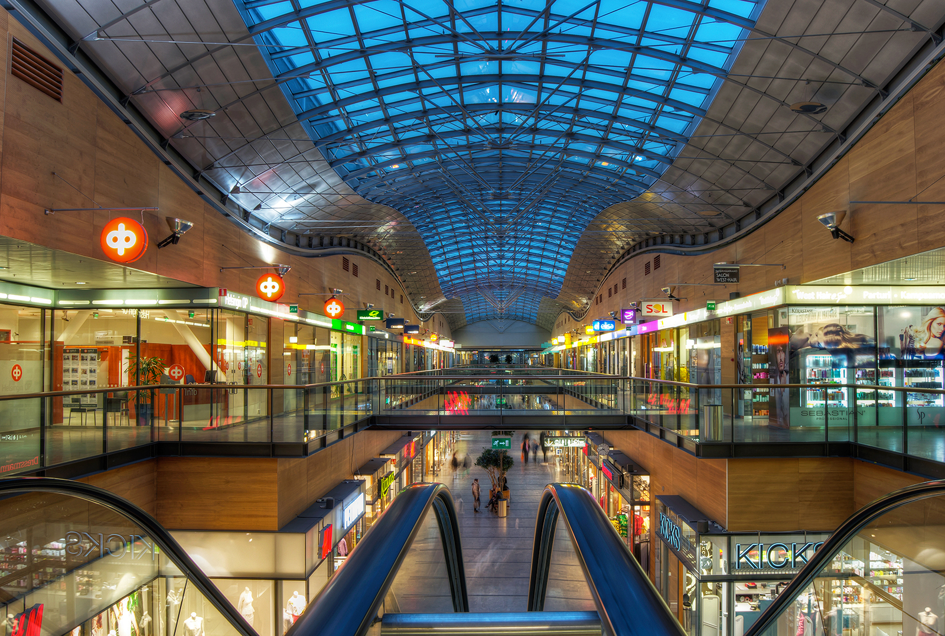
Big Apple
(Blog For Photos, 2012)
Iso Omena (Big Apple) is a big and successful shopping center in Helsinki.

Slide 6
Motivation
Little is yet known about these practices.
Understanding how a multi-organizational system is able to constantly creating value.
Study a new project management approach.

Slide 7
Objectives
Derivation of integration mechanisms.
Creation of propositions to apply in project management.
Derive a new project management approach.

Slide 8
Value Creation and System Lifecycle
Project Management adds value by achieving the outcome desired by stakeholders.
A system Lifecycle involves two major phases: the project phase and the operations phase.
These two phases are responsible for establishing an operational networked organization, in between.

Slide 9
Temporal Integration
Mutual adjustments and interactions are required due to the system complexity and dynamism throughout time.
Morris (1983) states that integration through planning is not necessarily effective.
Creating complex multi-organizational systems between multiple organizations in the two phases is the only effective way of value creation in the future.

Slide 10
Research Framework and Central Concepts
No earlier research in this specific subject.
Goal is to help form arrangements.
Analysis of value creating mechanisms existing in the operational phase.
Paper findings:
Going further than just building facilities.

Slide 11
Central Concepts (1)
Retailers
Operational
Architects,
Construction
Project

Slide 12
Central Concepts (2)
Owner
Project
Operational

Slide 13
Why?
Creation of value for customers
Profitable growth as individual and whole

Slide 14
Research Methods and Data (1)
Objective:
Analyze Integration Mechanisms among multiple organization within the Big Apple.
Interviewed:
12 senior members from 10 organizations;
All recommended by each other in terms of knowledge and practices on value enhancing activities.
Store Managers
CEOs
Development Directors

Slide 15
Research Methods and Data (2)
Interview focus:
Practices that connect the activity of multiple organizations;
Significant events where multiple organizations have been involved.
Joint Marketing Campaigns
Meetings
Analyzing documents, archived data and newspapers articles about these practices and their results.

Slide 16
Research Methods and Data (3)
Micro-level analysis
Micro-level analysis
Development of summaries
Development of visual models
Allowed to derive 4 Integration Mechanisms

Slide 17
Development of IMs
Value Creation
Coordinating body
Non-living technical system
External image and internal identity
Competing businesses and value
Notes:
We have categorized the four integration mechanisms and propositions concerning new project management approaches under four themes.
These mechanisms connected multiple organizations within Big Apple's operations.

Slide 18
Coordinating Body (1)
There must be a coordination of activities.
Coordinating bodies in Big Apple:
Citycon - Owner;
Linnunrata – Advertising agency;
Shopkeeper association.
Notes:
Individual business cannot survive alone;
Shopping centers mostly compete for customer footfall with other nearby shopping centers and department stores by offering multiple differentiated businesses and their brands, as well as public and municipal services;
In Big Apple several organizations (coordenating bodies) were established to create na ideal mix.

Slide 19
Coordinating Body (2)
Owner:
Actors selection;
Long-term value creation;
Managing conflicting interests.
Shopkeeper association:
Informal joint activities:
“Change for the better began in 2004. Actually, there was an obvious date when this all began — the date of the shopkeeper association's joint excursion. (…)”
Linnunrata
“Monday-morning coffee”
Notes:
Owner:
Integrator had na understanding of the bigger picture;
Avoiding sub-optimal arrangements;
Avoiding situations in wich individuals would only attempt to optimize their own short term business objectives without contributing to the value of the shopping center as a hole.
At times, the owner's decisions conflicted with the business interests of individual actors. For example, the owner chose to impose long opening hours, ensuring that all shops within Big Apple were also open on Sundays.
Linn: Informal coordenating role;
With the center owner
stakeholders
store managers

Slide 20
Coordinating Body (3)
IM Proposition 1:
“Establishing several coordinating bodies in a project enhances value creation in that project by developing a coordinated network of organizations that can transform into a smoothly-functioning multi-organizational system in the operations phase.”
Notes:
Coordinationg bodies since the begining enhance the value over the system lifecycle.
Advertising companies - Joint activities
User associations – integrative activities
Project management approaches:
-encourage organizational arrangements that allow for “openess and flexability” to emerge – entrepreneurial individuals
Integration Mechanism 1:
“A coordinating body that integrates activities in commercial operations by multiple organizations is an essential element for joint value creation within the entire system.”

Slide 21
External Image and Internal Identity (1)
Joint activities to design a brand image and marketing strategies in collaboration with an advertisement agency throughout the operations phase.
Board members fostered a feeling of pride for Big Apple being superior to other Shopping centers and promoted to other stakeholders the idea of their customers being the best.

Slide 22
External Image and Internal Identity (3)
IM Proposition 2:
“Involving multiple organizations from different phases of the system lifecycle in external image building activities early in a project contributes to increased integrative value-enhancing activities and identity building within that project, and also connects organizations in the project and operations phases through a shared brand image and identity.”

Slide 23
Non-living technical system and living organizational system (1)
Non-living technical system:
It’s iterative and changes. This changes can not affect the living organizational system;
Observations indicated:
A multi-organizational setting is a living business organism;
It is required to adapt the non-living build environment context and its technical systems to different business needs.

Slide 24
Non-living technical system and living organizational system (2)
Analysis shows that:
Business actors and public service providers are active in launching initiatives based on their own business visions;
The creation of different scenarios for use of the technical system is essential in the project phase.

Slide 25
Non-living technical system and living organizational system (3)
IM Proposition 3:
“Creating long-term scenarios involving possible future developments in the multi-organizational business system of the operations phase and the careful selection of an appropriate strategy for incorporating flexibility into the design of the capital element and its technical systems are likely to increase the system's use value.”
Notes:
As cores aqui nao estao bem

Slide 26
Competing Businesses and Value (1)
Multiple similar competing product and service offerings, differentiated brands:
“multiple fashion stores, two large hypermarkets and numerous restaurants and coffee shops.”
Collaborative activities:
“the city library ran a theme campaign featuring novels but also advised visitors about the local bookshop's offering”
“supermarket and a liquor store jointly operate a beverage container recycling point.”

Slide 27
Competing Businesses and Value (2)
Creation of value through competition:
Provide a wide selection businesses and brands.
Incentive for each store to differentiate itself.
Broader set offerings, more choice for customers.
Increased shopping center attractiveness, better overall results.

Slide 28
Competing Businesses and Value (3)
IM Proposition 4:
“Starting in the project phase, value creation over the lifetime of a multi-organizational system can be enhanced by involving a combination of business organizations with operations that include internally-competing offerings and brands.”
Notes:
IM4:
Individual organizations competing within a multi- organizational system increase value for both the final customer and the system as a whole because as a single integrated system, the competing organizations working together represent a broader overall offering to final customers than would be the case with similar organizations in a non-competitive setting.

Slide 29
Discussion (1)
This detailed level of analysis is new to research on the theme of long-term value creation in projects;
New project management approaches will aim at creating an appropriately-designed organizational system;

Slide 30
Discussion (2)
Proposition 1:
Multiple coordinating bodies are involved at an early stage complements previous research.
Proposition 2:
Concerns with external image and internal identity based on the observation that joint activities aimed at external image building server as integration mechanisms.

Slide 31
Discussion (3)
Proposition 3:
Is based on the observation that the continuously changing organizational system in the operations phase of a shopping center raises continuing demands for changes in the center’s technical system.
Proposition 4:
Establishes that an optimal mix of organizations with competing and complementary offering can be selected at an early stage in the project phase.

Slide 32
Discussion (4)
Future Research:
The System lifecycle;
Multi-organizational system.
The system lifecycle can be examined from the viewpoint of a more general concept of ‘time’.
Multi-organizational systems should be viewed more broadly as ‘multiple stakeholders’.

Slide 33
Results
Sales 181.6 M€
Visitors 8.0 M/year
Gross leasable area 62,700 m²
Retail premises 50,100 m²
Number of stores 114
Parking spaces 2,200
Notes:
For reference:
Finlandia tem 5 milhoes de pessoas
Colombo passam 20 milhoes (2012)
Iso Omena attracts approximately 25,800 customers on weekdays, 22,600 on Saturdays and 13,600 on Sundays.
The paper has some problems such as:
- Será que é possível aplicar a qualquer projeto ou só em casos específicos como este?
- Beginning of the project, it should have started from the project phase instead of the operations? To trully study the product lifecycle.
- There is no study of this methods and there is no way to really say if they work or not. The measure for success used is very subjective.
- Not very “scientific”.
They say without any justification that competition is good for the shopping center as a hole and so good for each and every individual store. But they say this without any justification beyond intuition that having a bigger sample of different and similar products is more attractive for the client.
- In a lot of ways
- Of 12 stores, in which every participant would suggest another one, cannot do this if you want to diversify.

Slide 34
Our Review
Statistical sample – One Shopping center.
Beginning of the project – should have started from the beginning of the operations phase.
No precise measure for success.
Lack of statistical information.
Based on 12 interviews.
Mentioning results in the Prior literature chapter.
Notes:
Cautela ver as cores!!
The paper has some problems such as:
- Será que é possível aplicar a qualquer projeto ou só em casos específicos como este?
- Beginning of the project, it should have started from the project phase instead of the operations? To trully study the product lifecycle.
- There is no study of this methods and there is no way to really say if they work or not. The measure for success used is very subjective.
- Not very “scientific”.
They say without any justification that competition is good for the shopping center as a hole and so good for each and every individual store. But they say this without any justification beyond intuition that having a bigger sample of different and similar products is more attractive for the client.
- In a lot of ways
- Of 12 stores, in which every participant would suggest another one, cannot do this if you want to diversify.

